Slide 1
Lecture 5
Advanced Algorithm Analysis

Slide 2
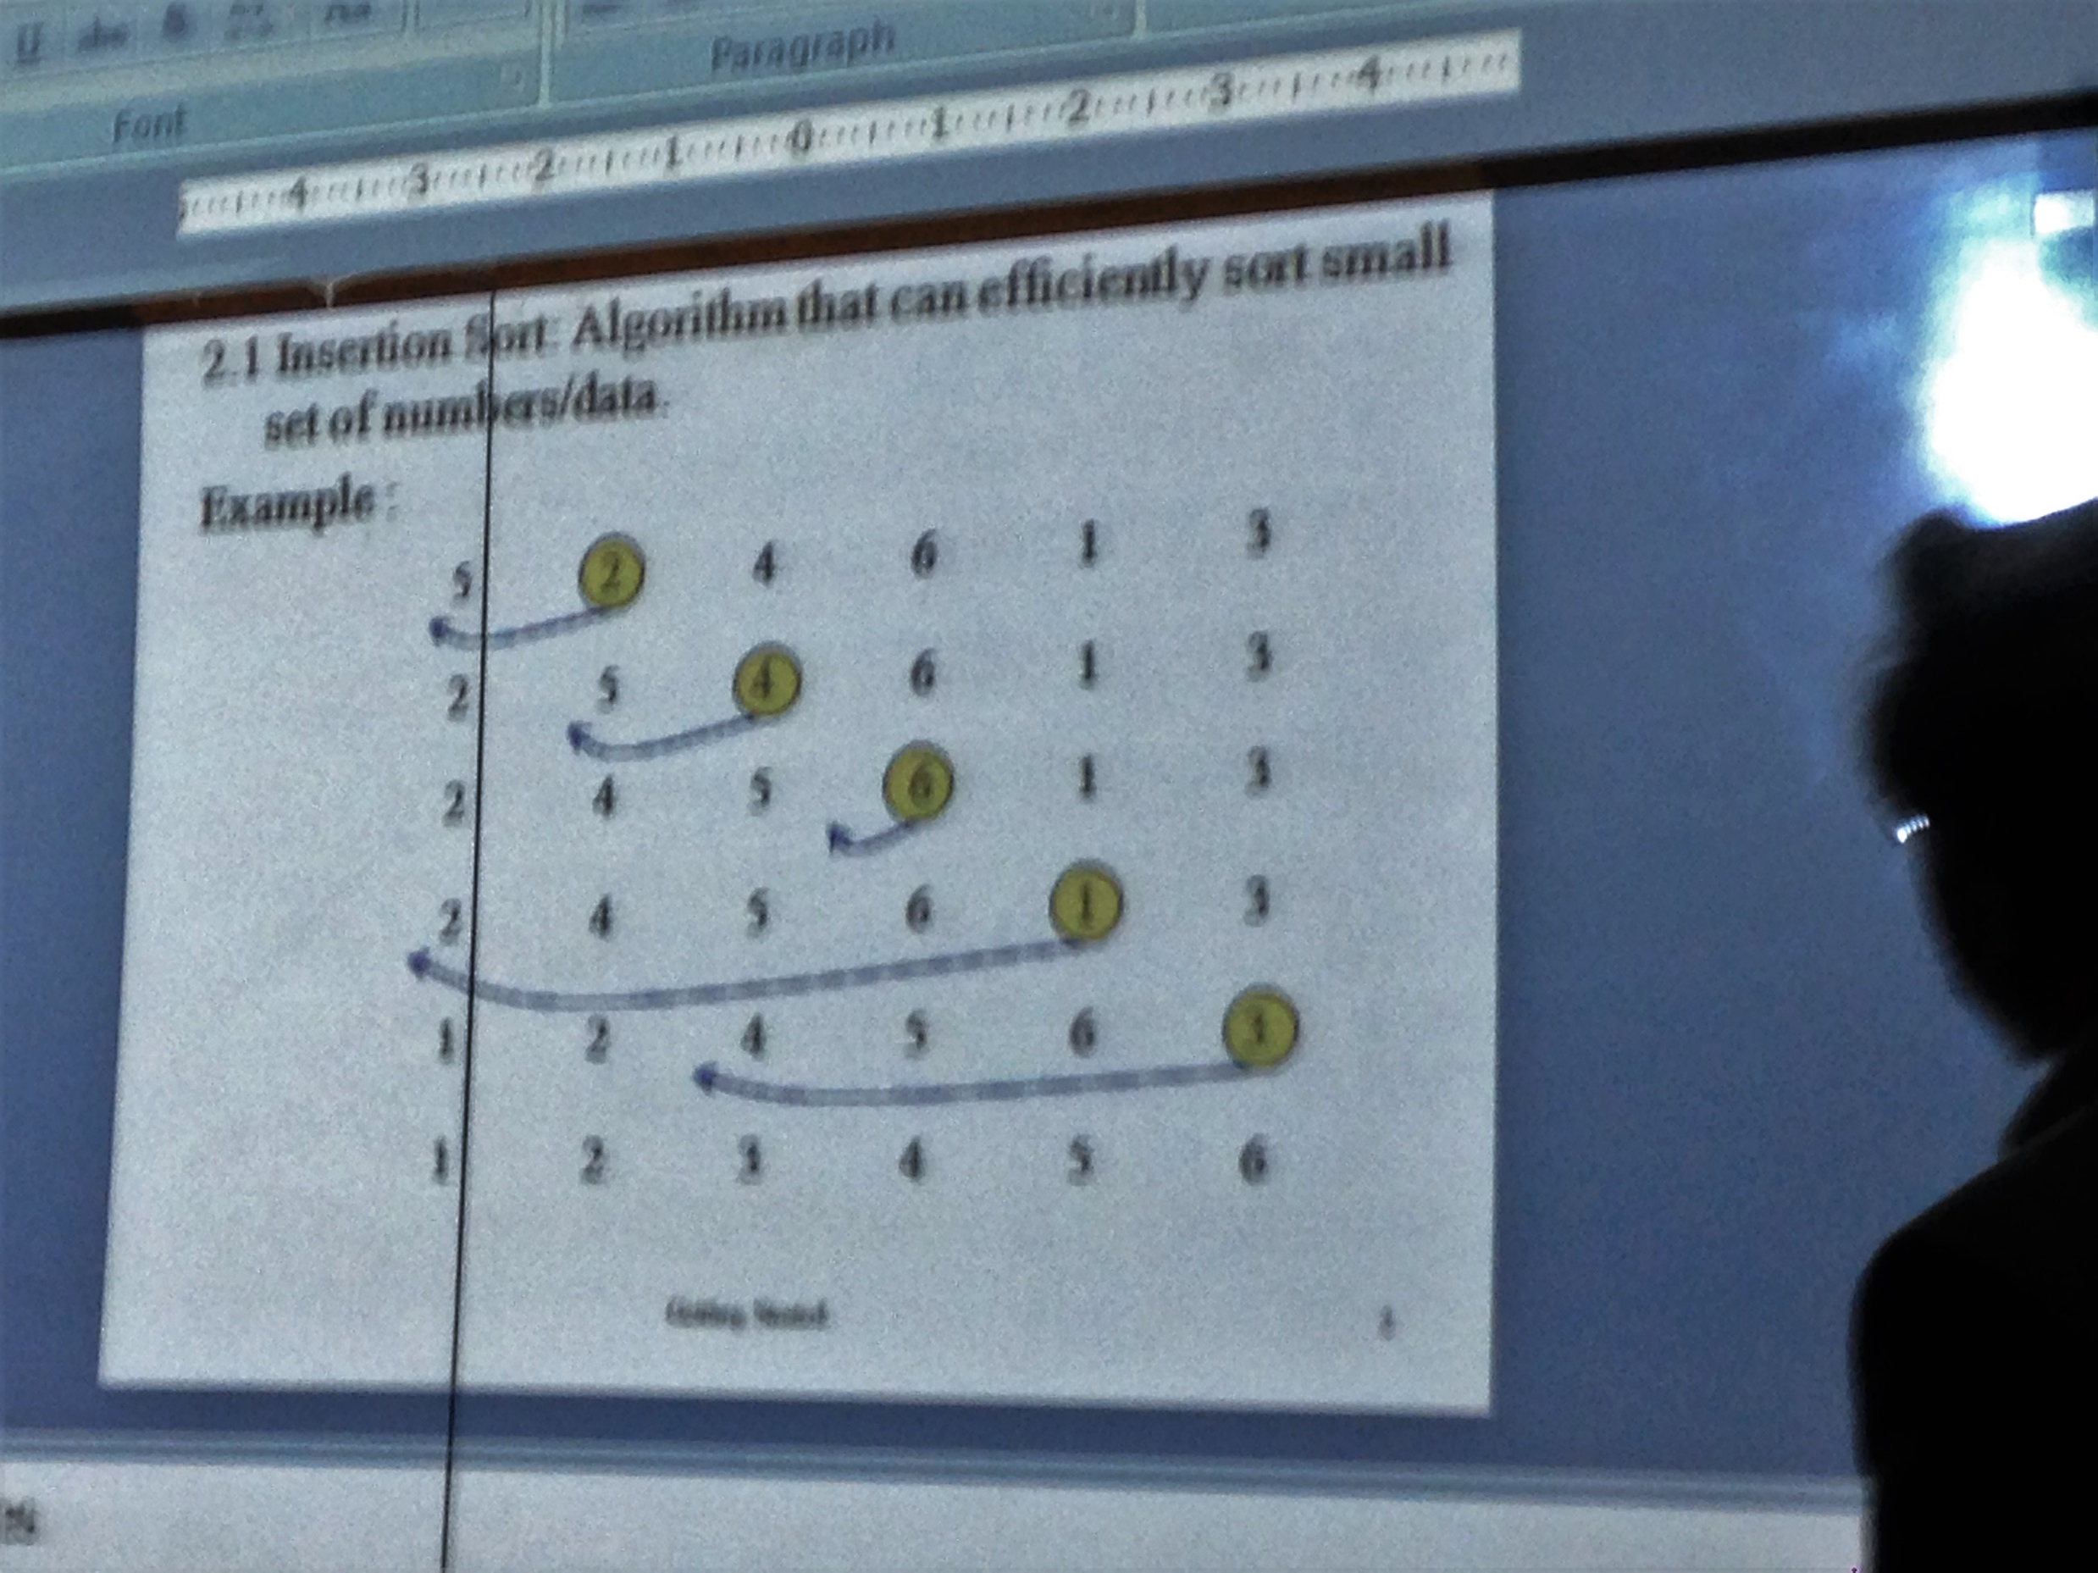
Insertion Sort Review

Slide 3
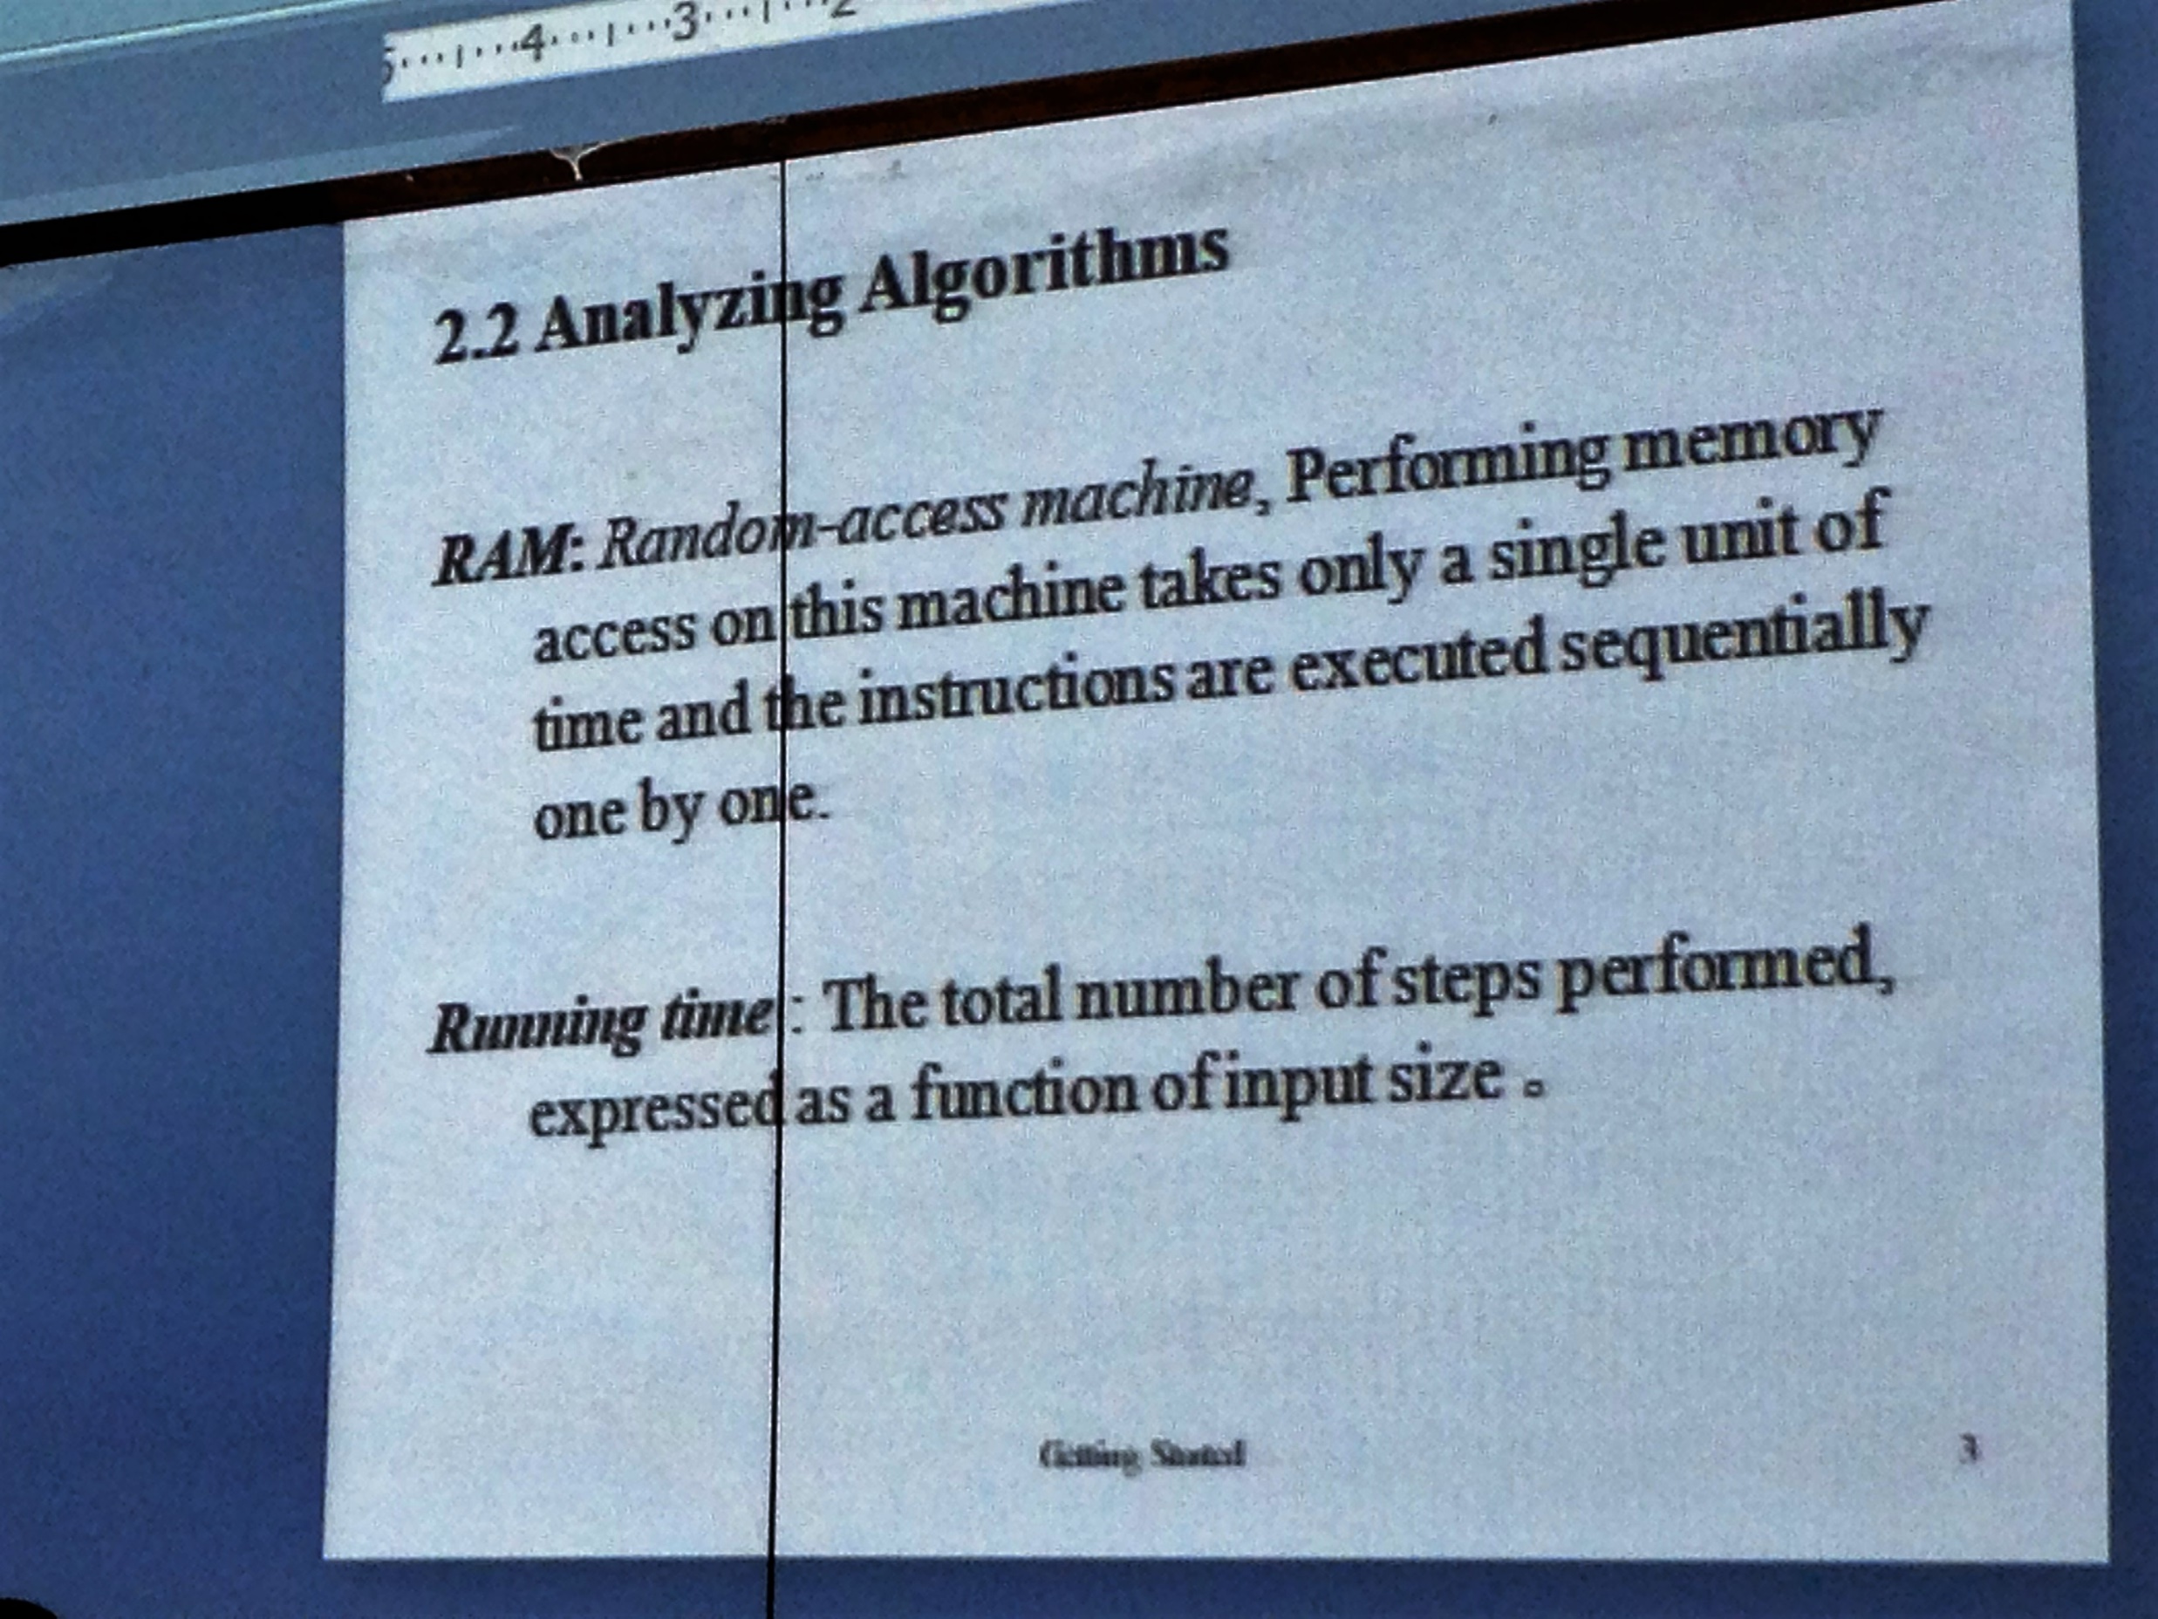
Random Access Machine

Slide 4
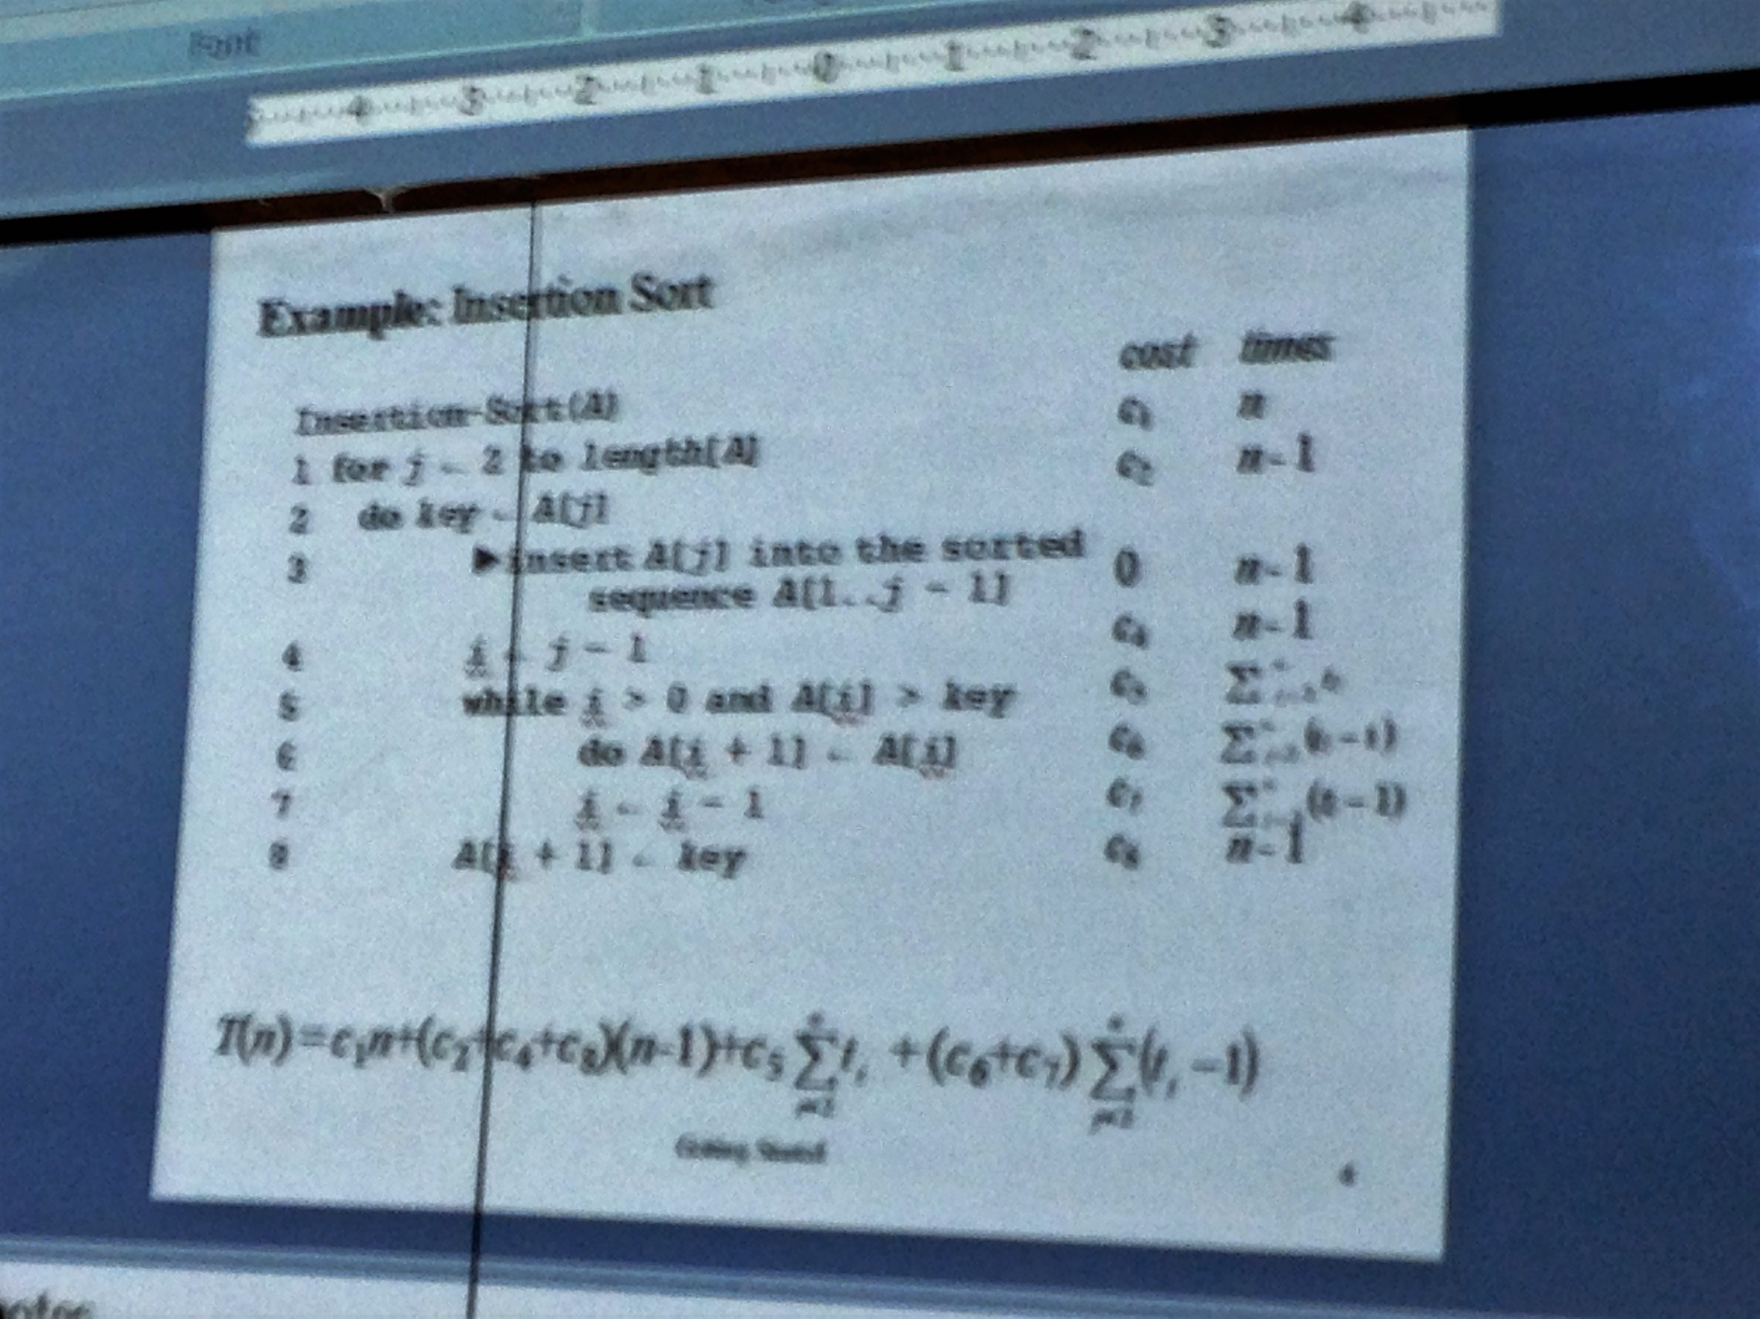
Insertion Sort Algorithm

Slide 5
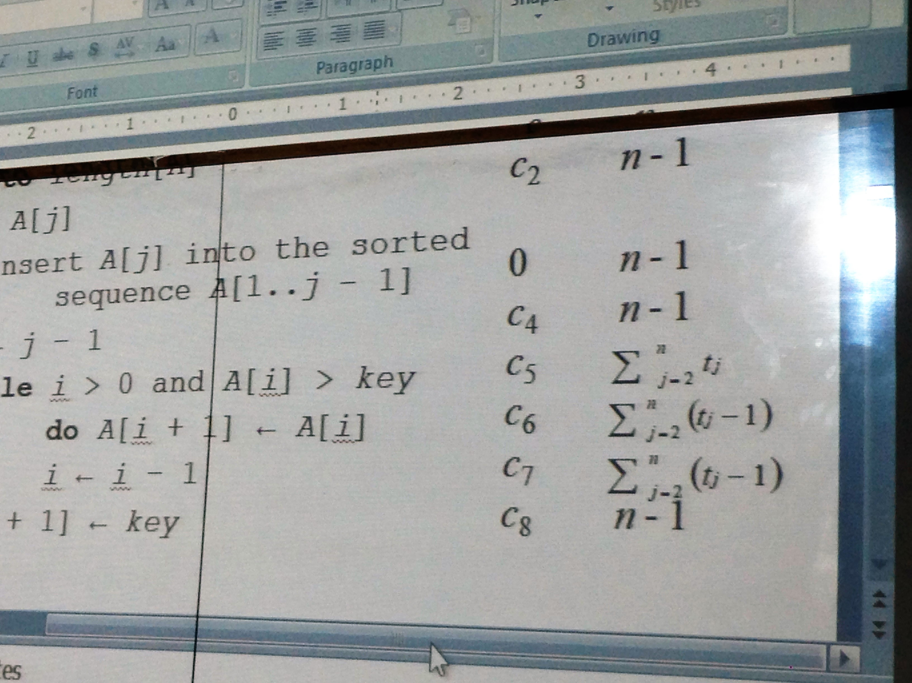
Insertion Sort Algorithm

Slide 6
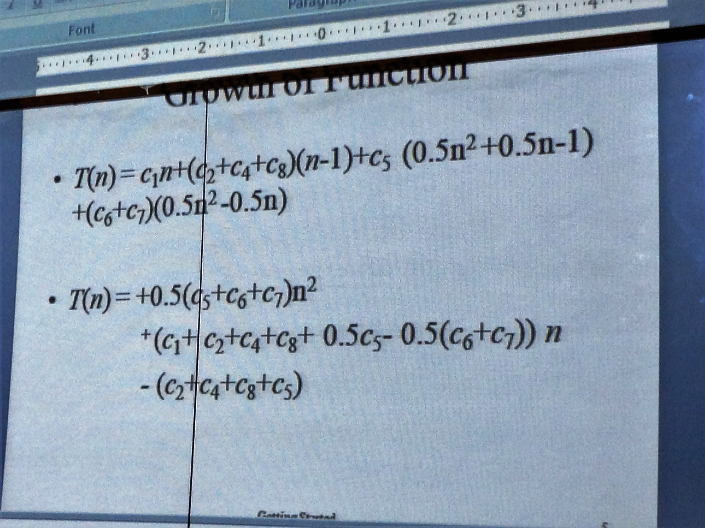
Growth of Function (Insertion Sort)

Slide 7
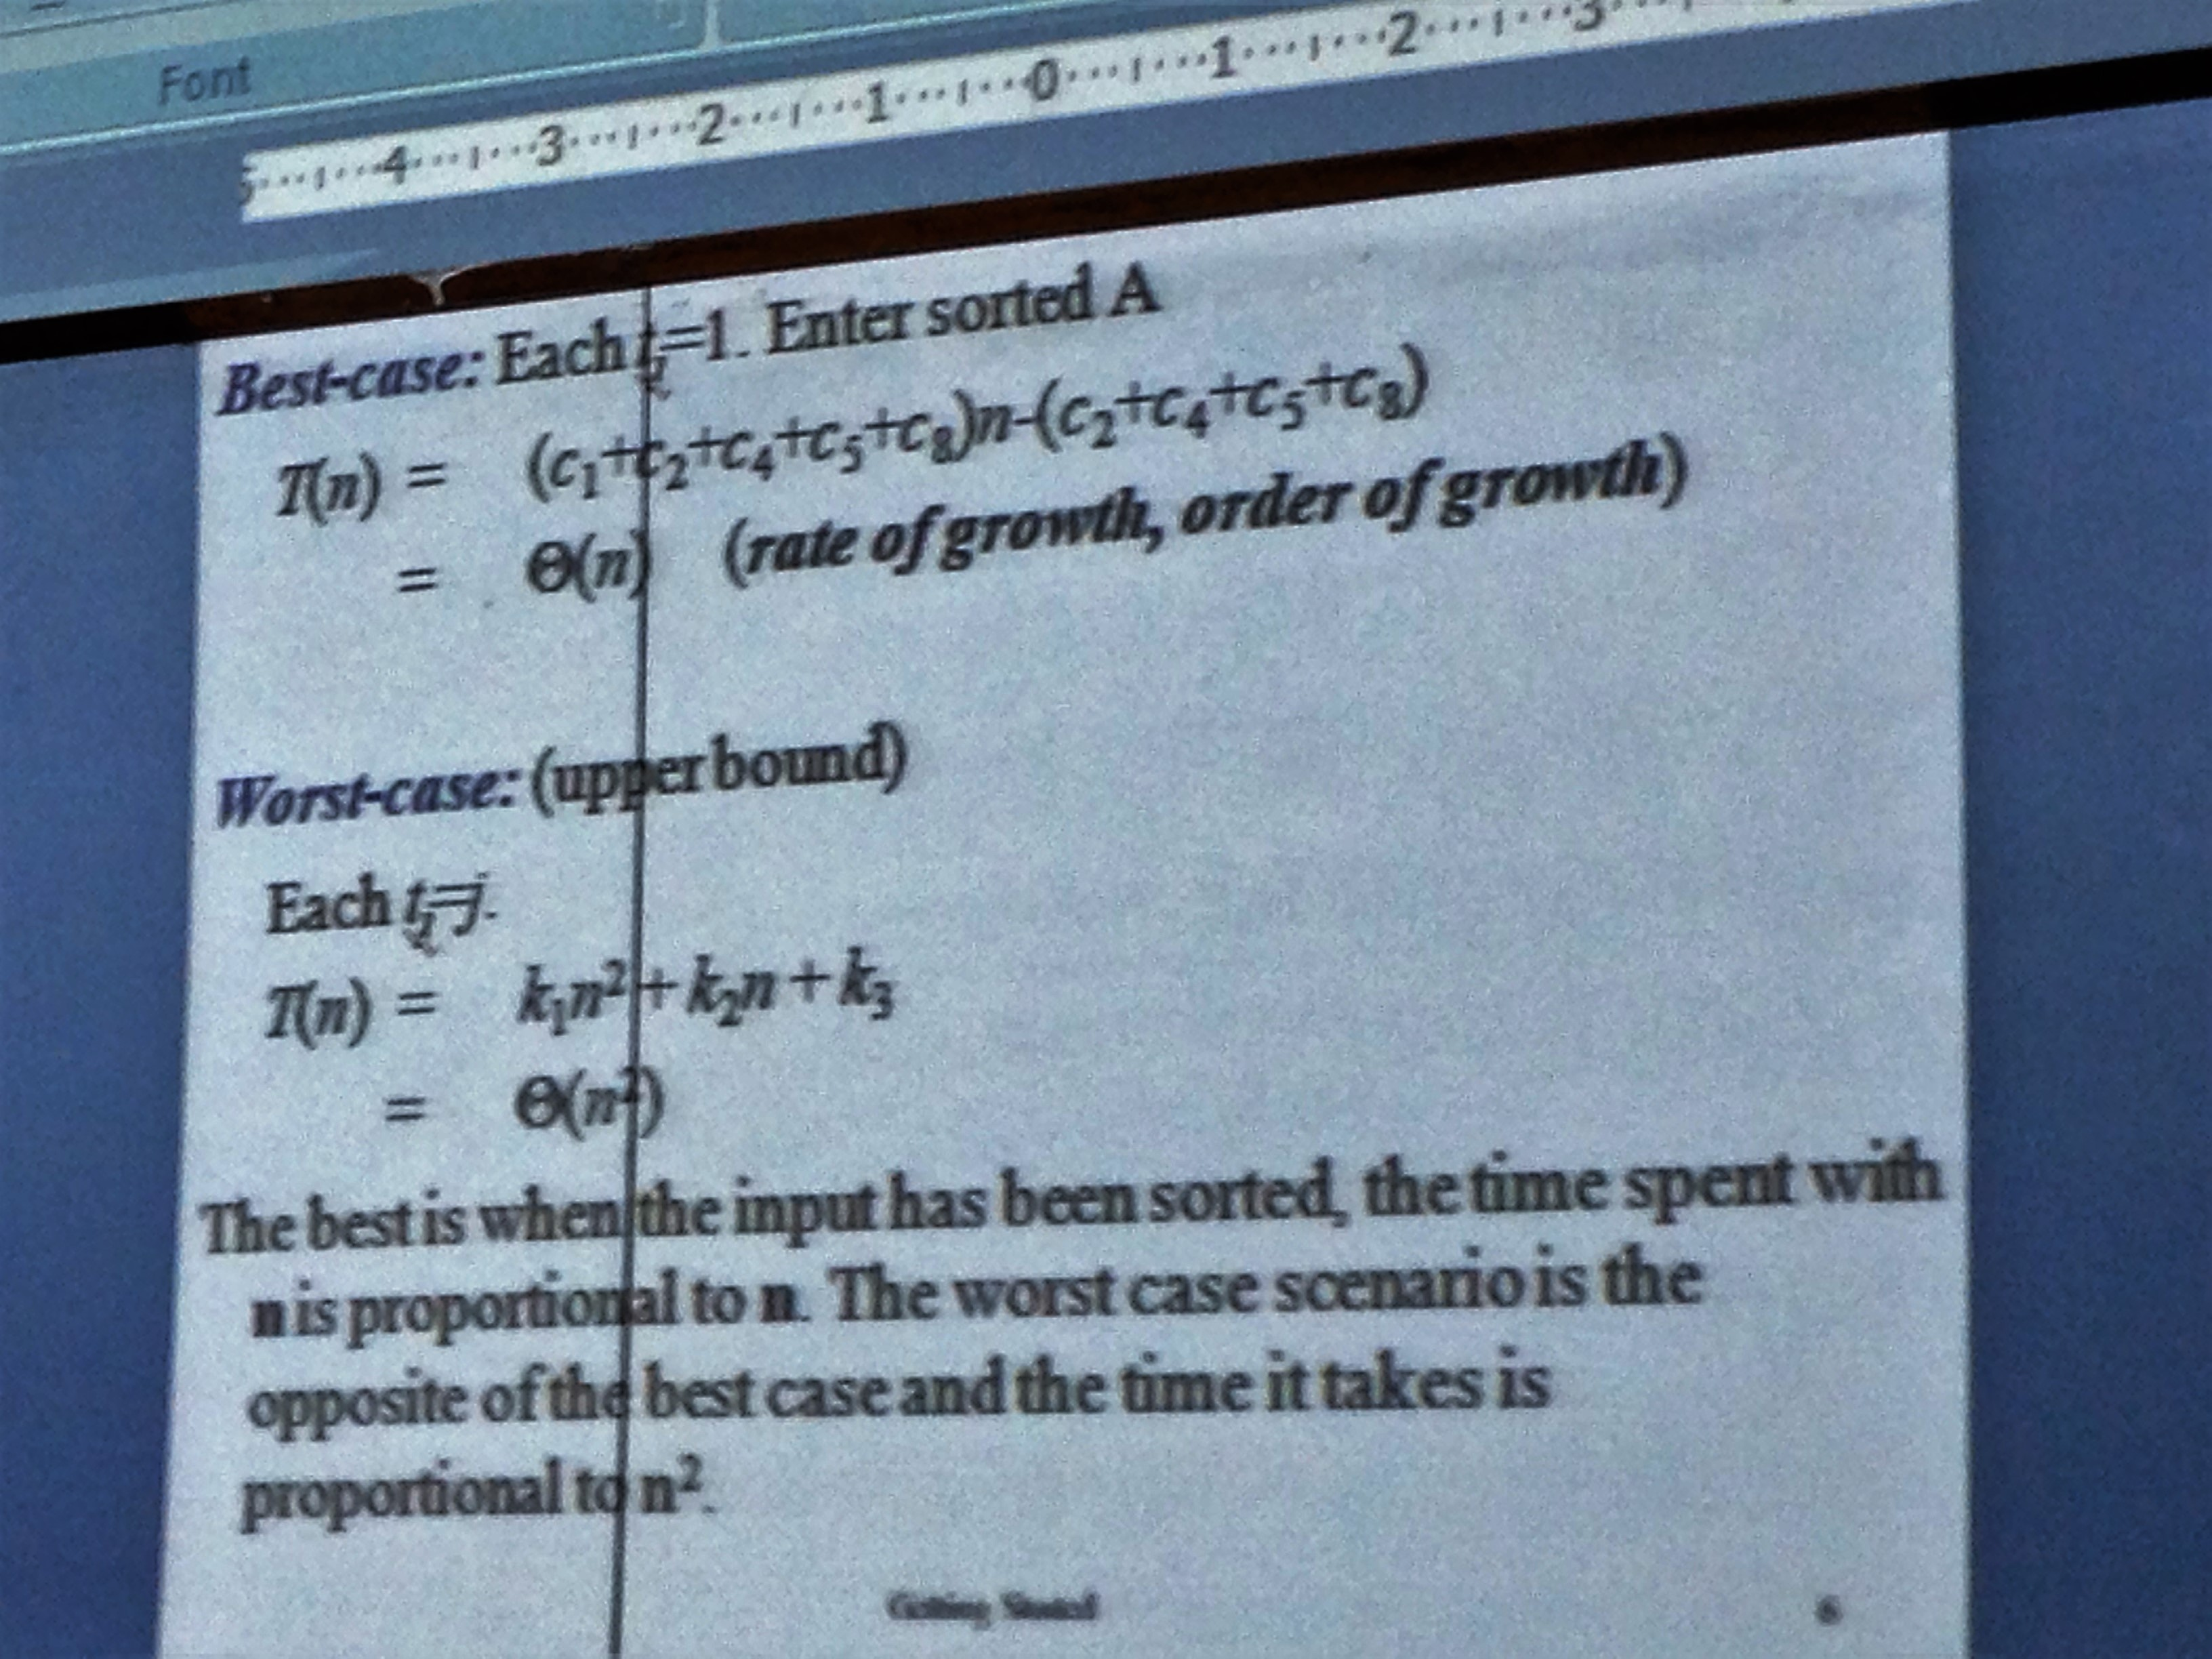
Rate of Growth for best and worst case

Slide 8
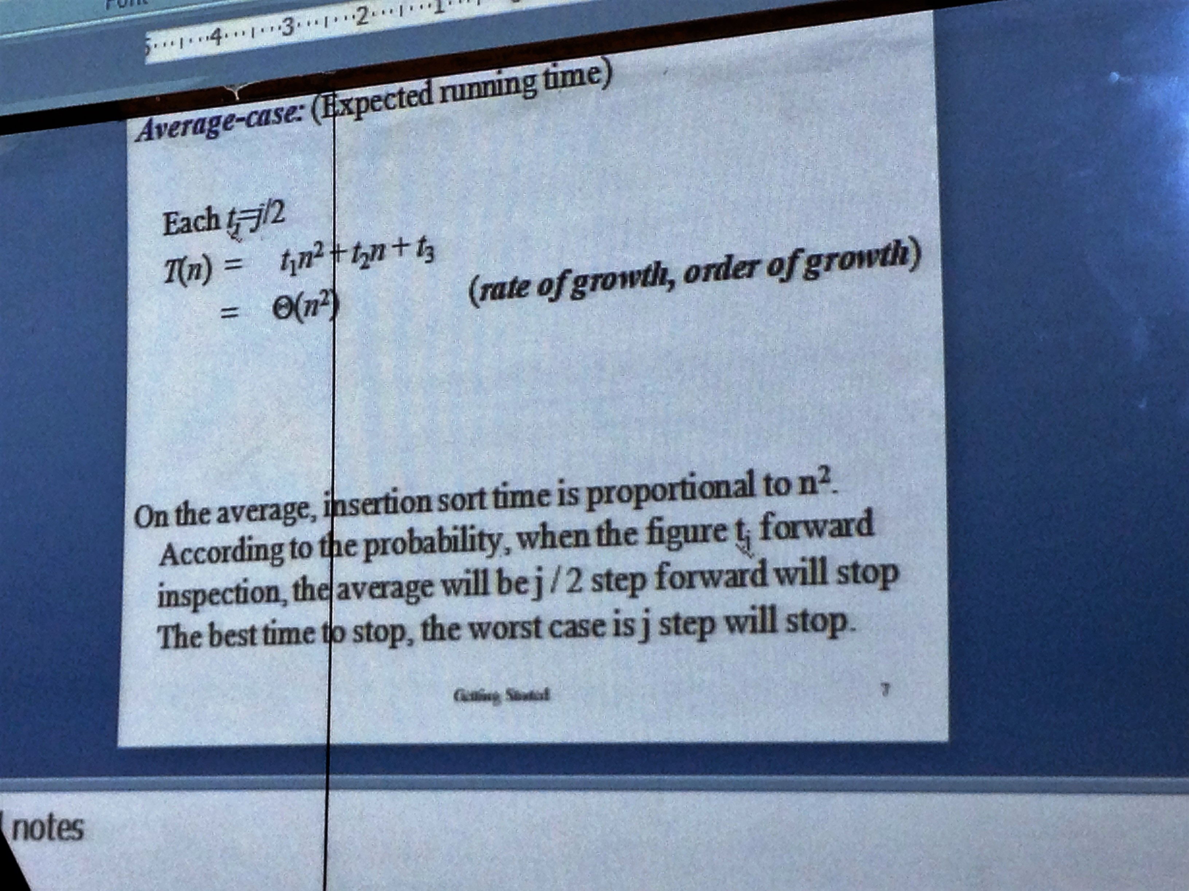
Rate of Growth for average case

Slide 9
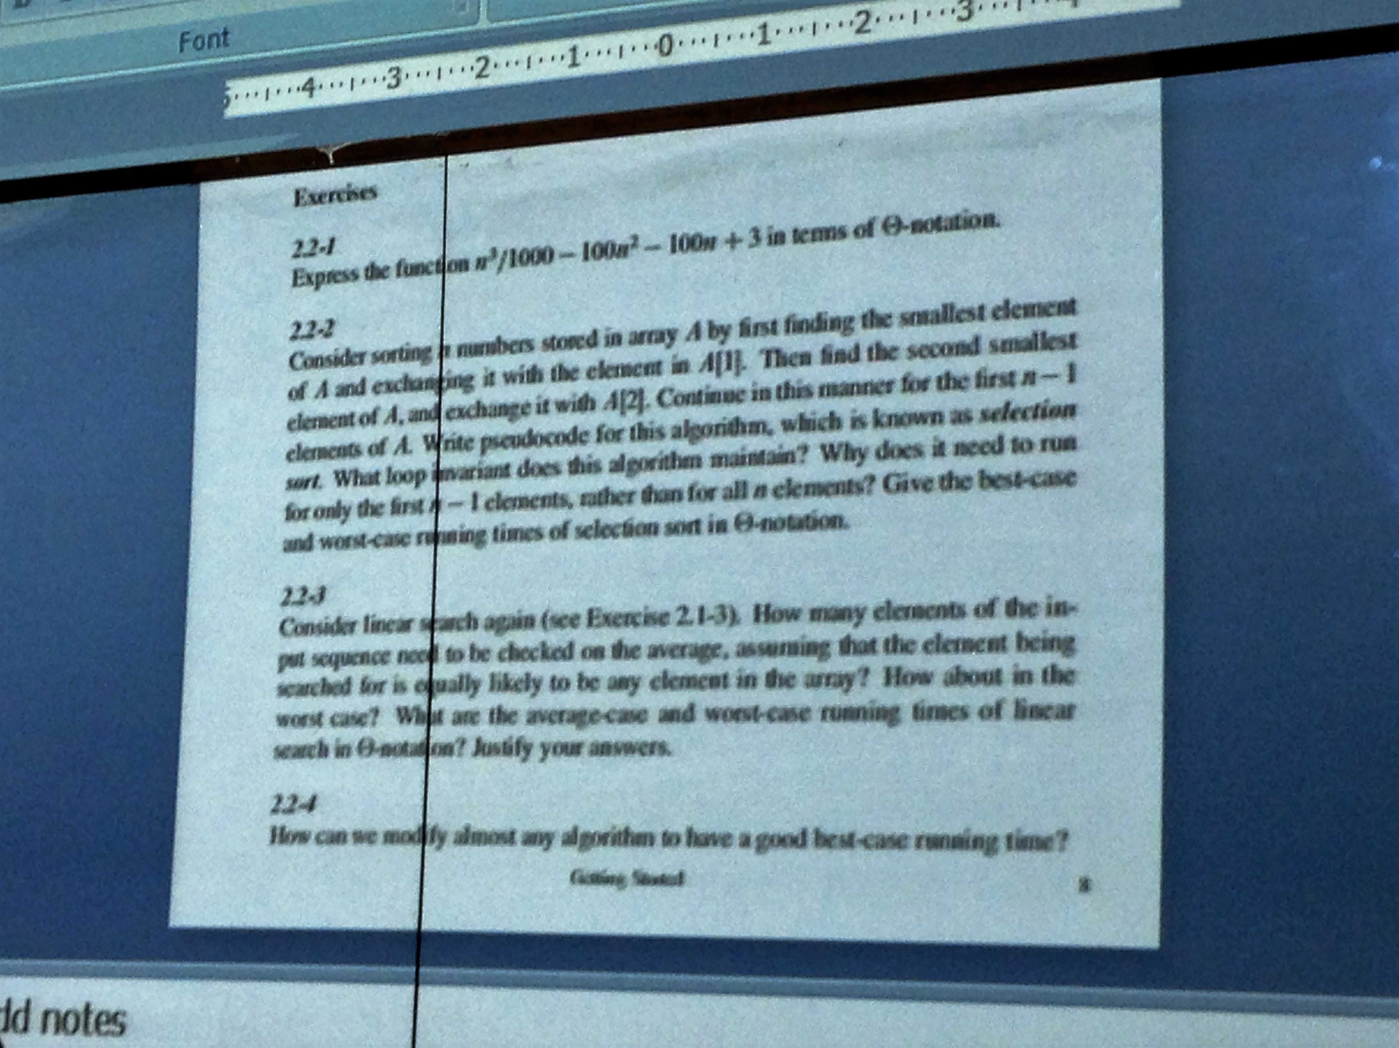
Exercise Questions

Slide 10
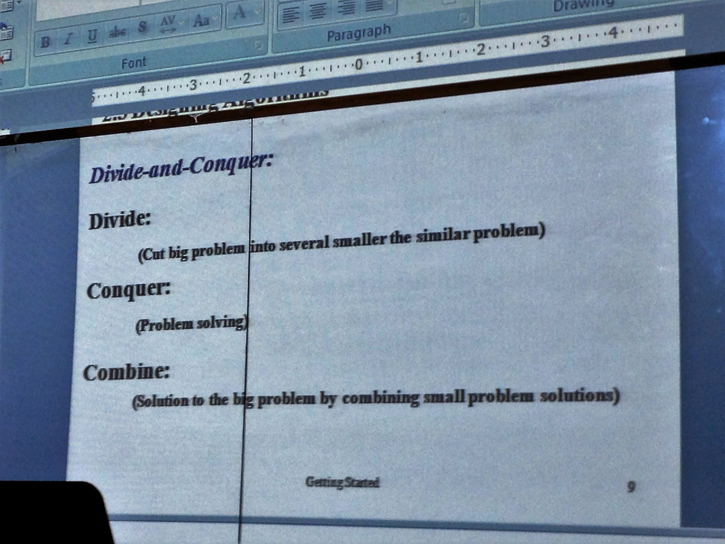
Divide and Conquer

Slide 11
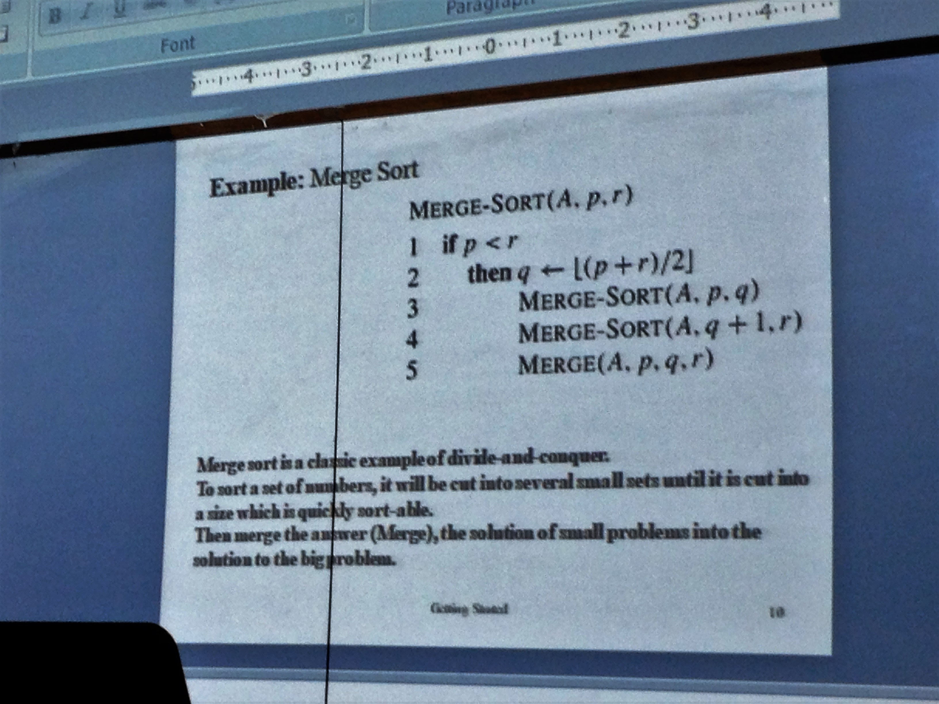
Example of divide and conquer

Slide 12
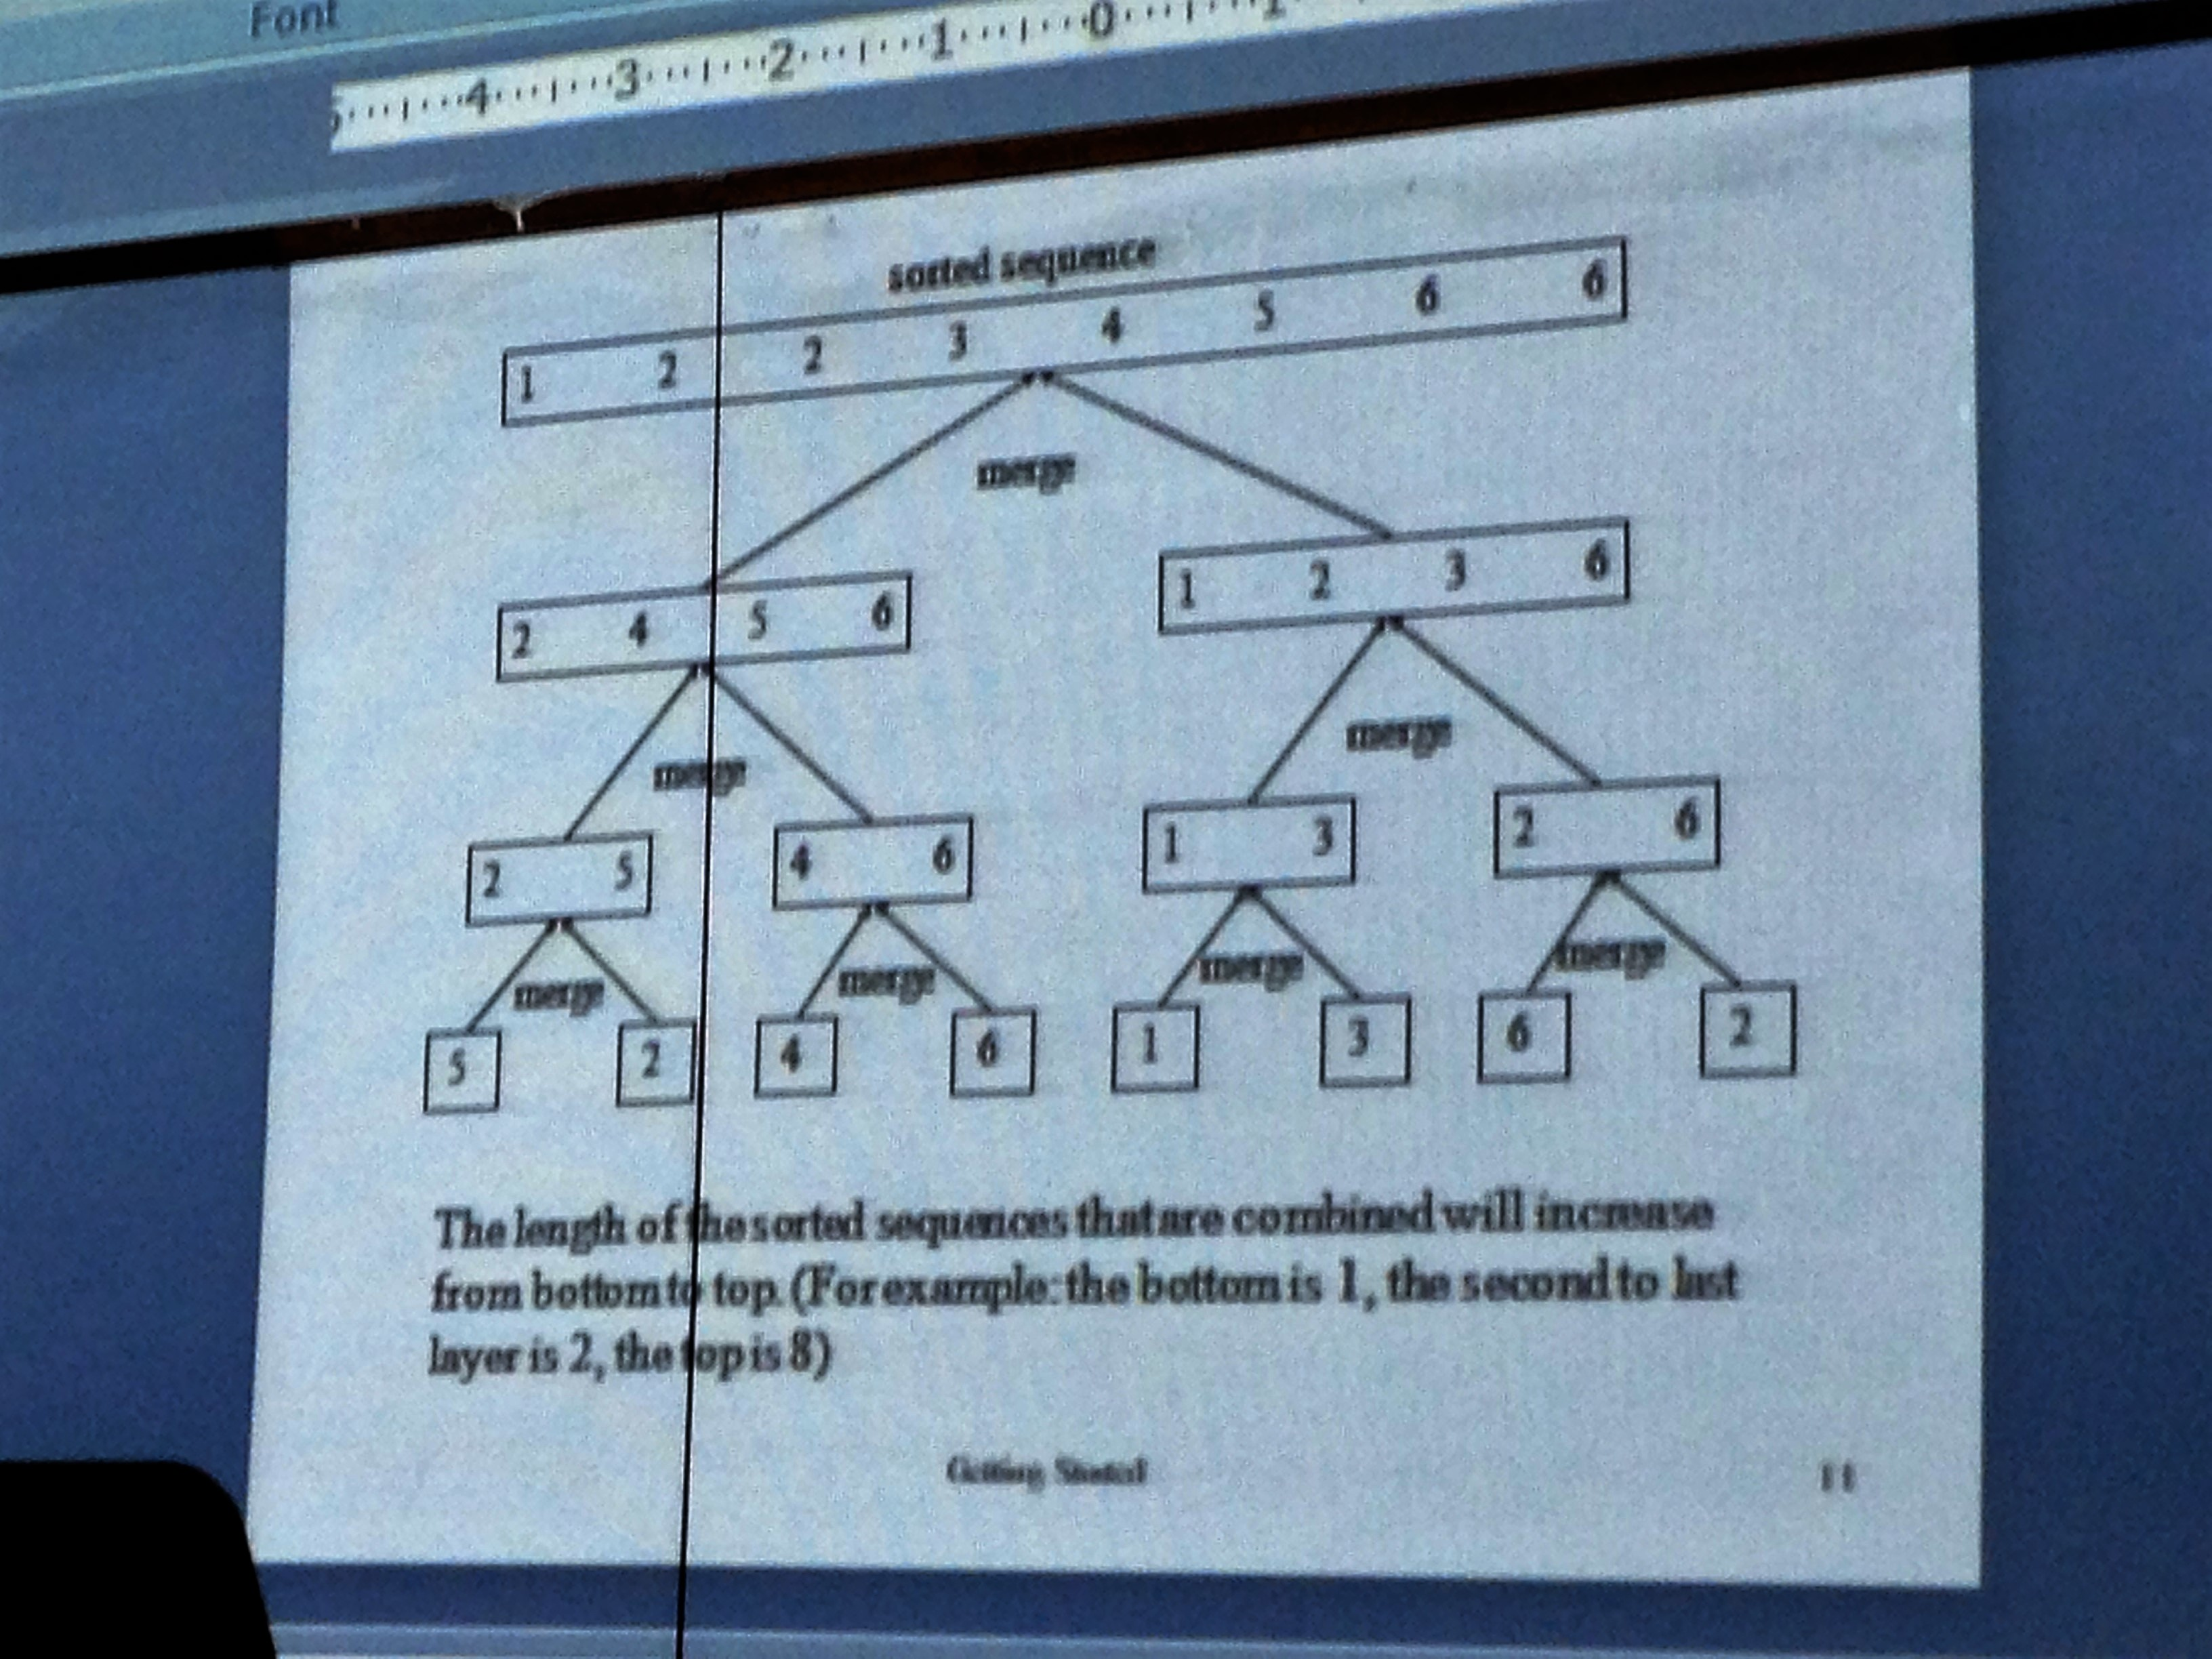
Merge Sort

Slide 13
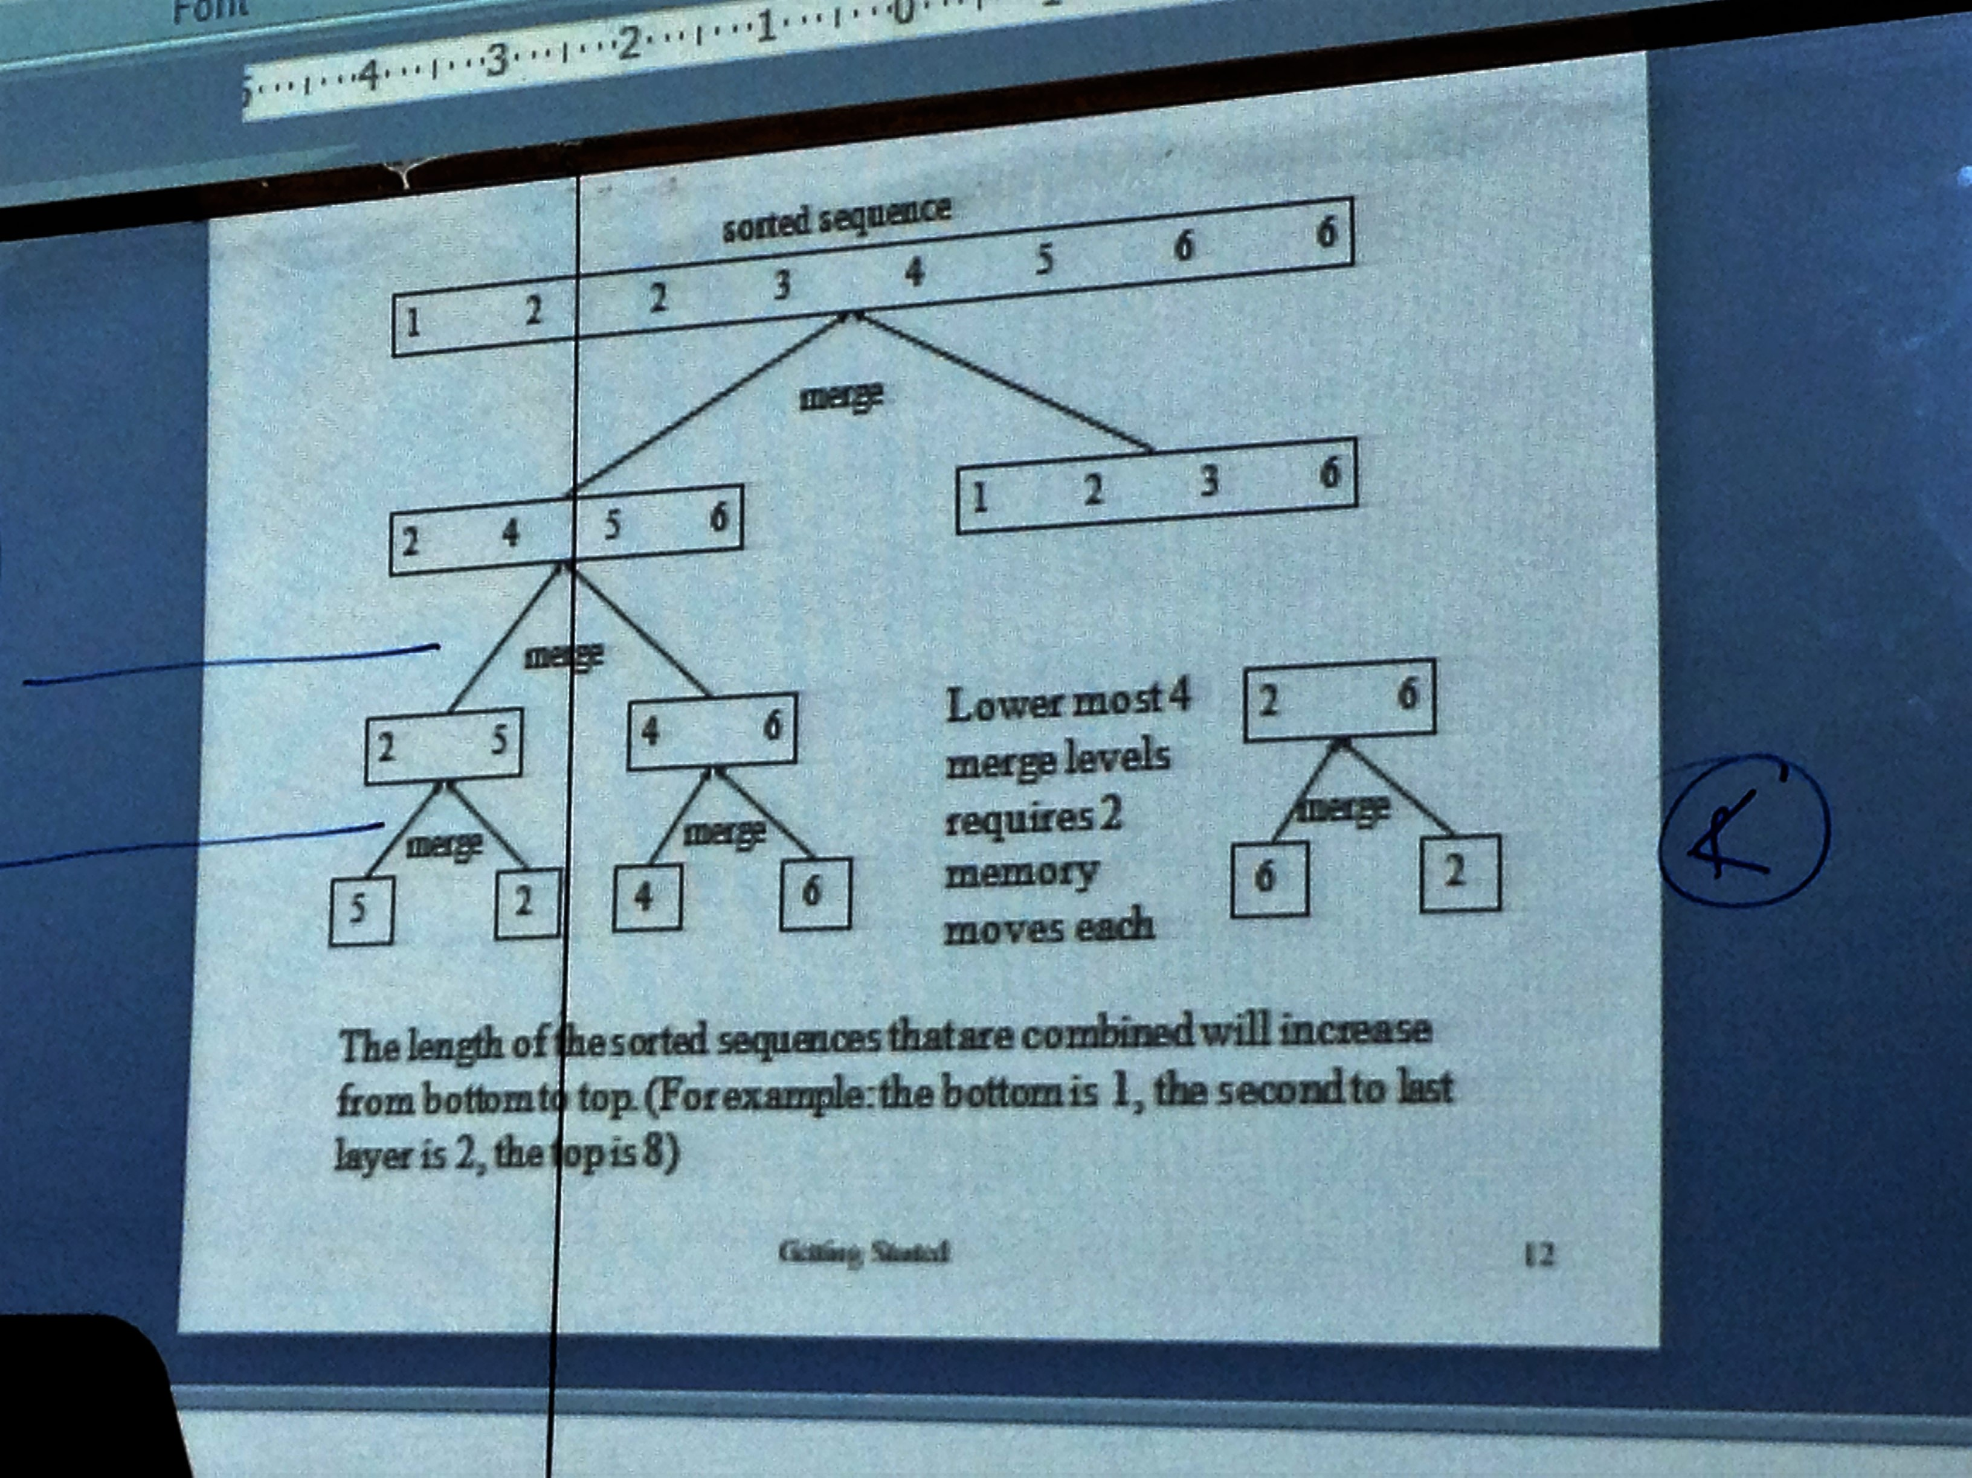
Merge Sort (contd…)

Slide 14
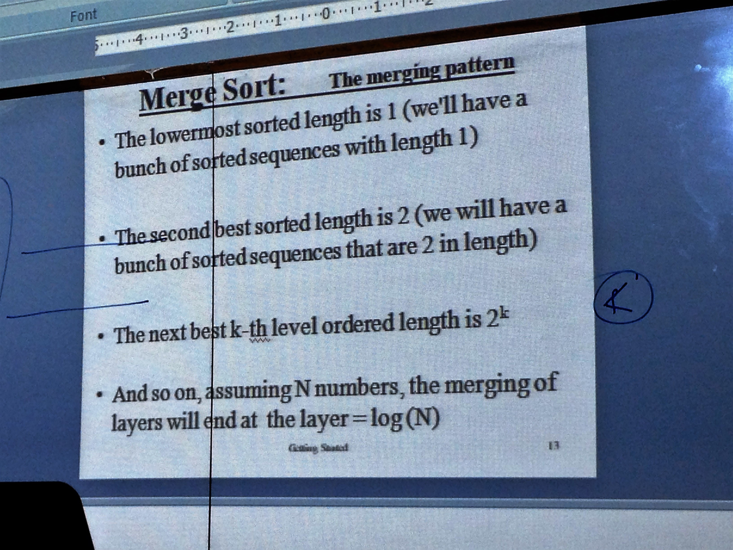
Merge Sort (contd…)

Slide 15
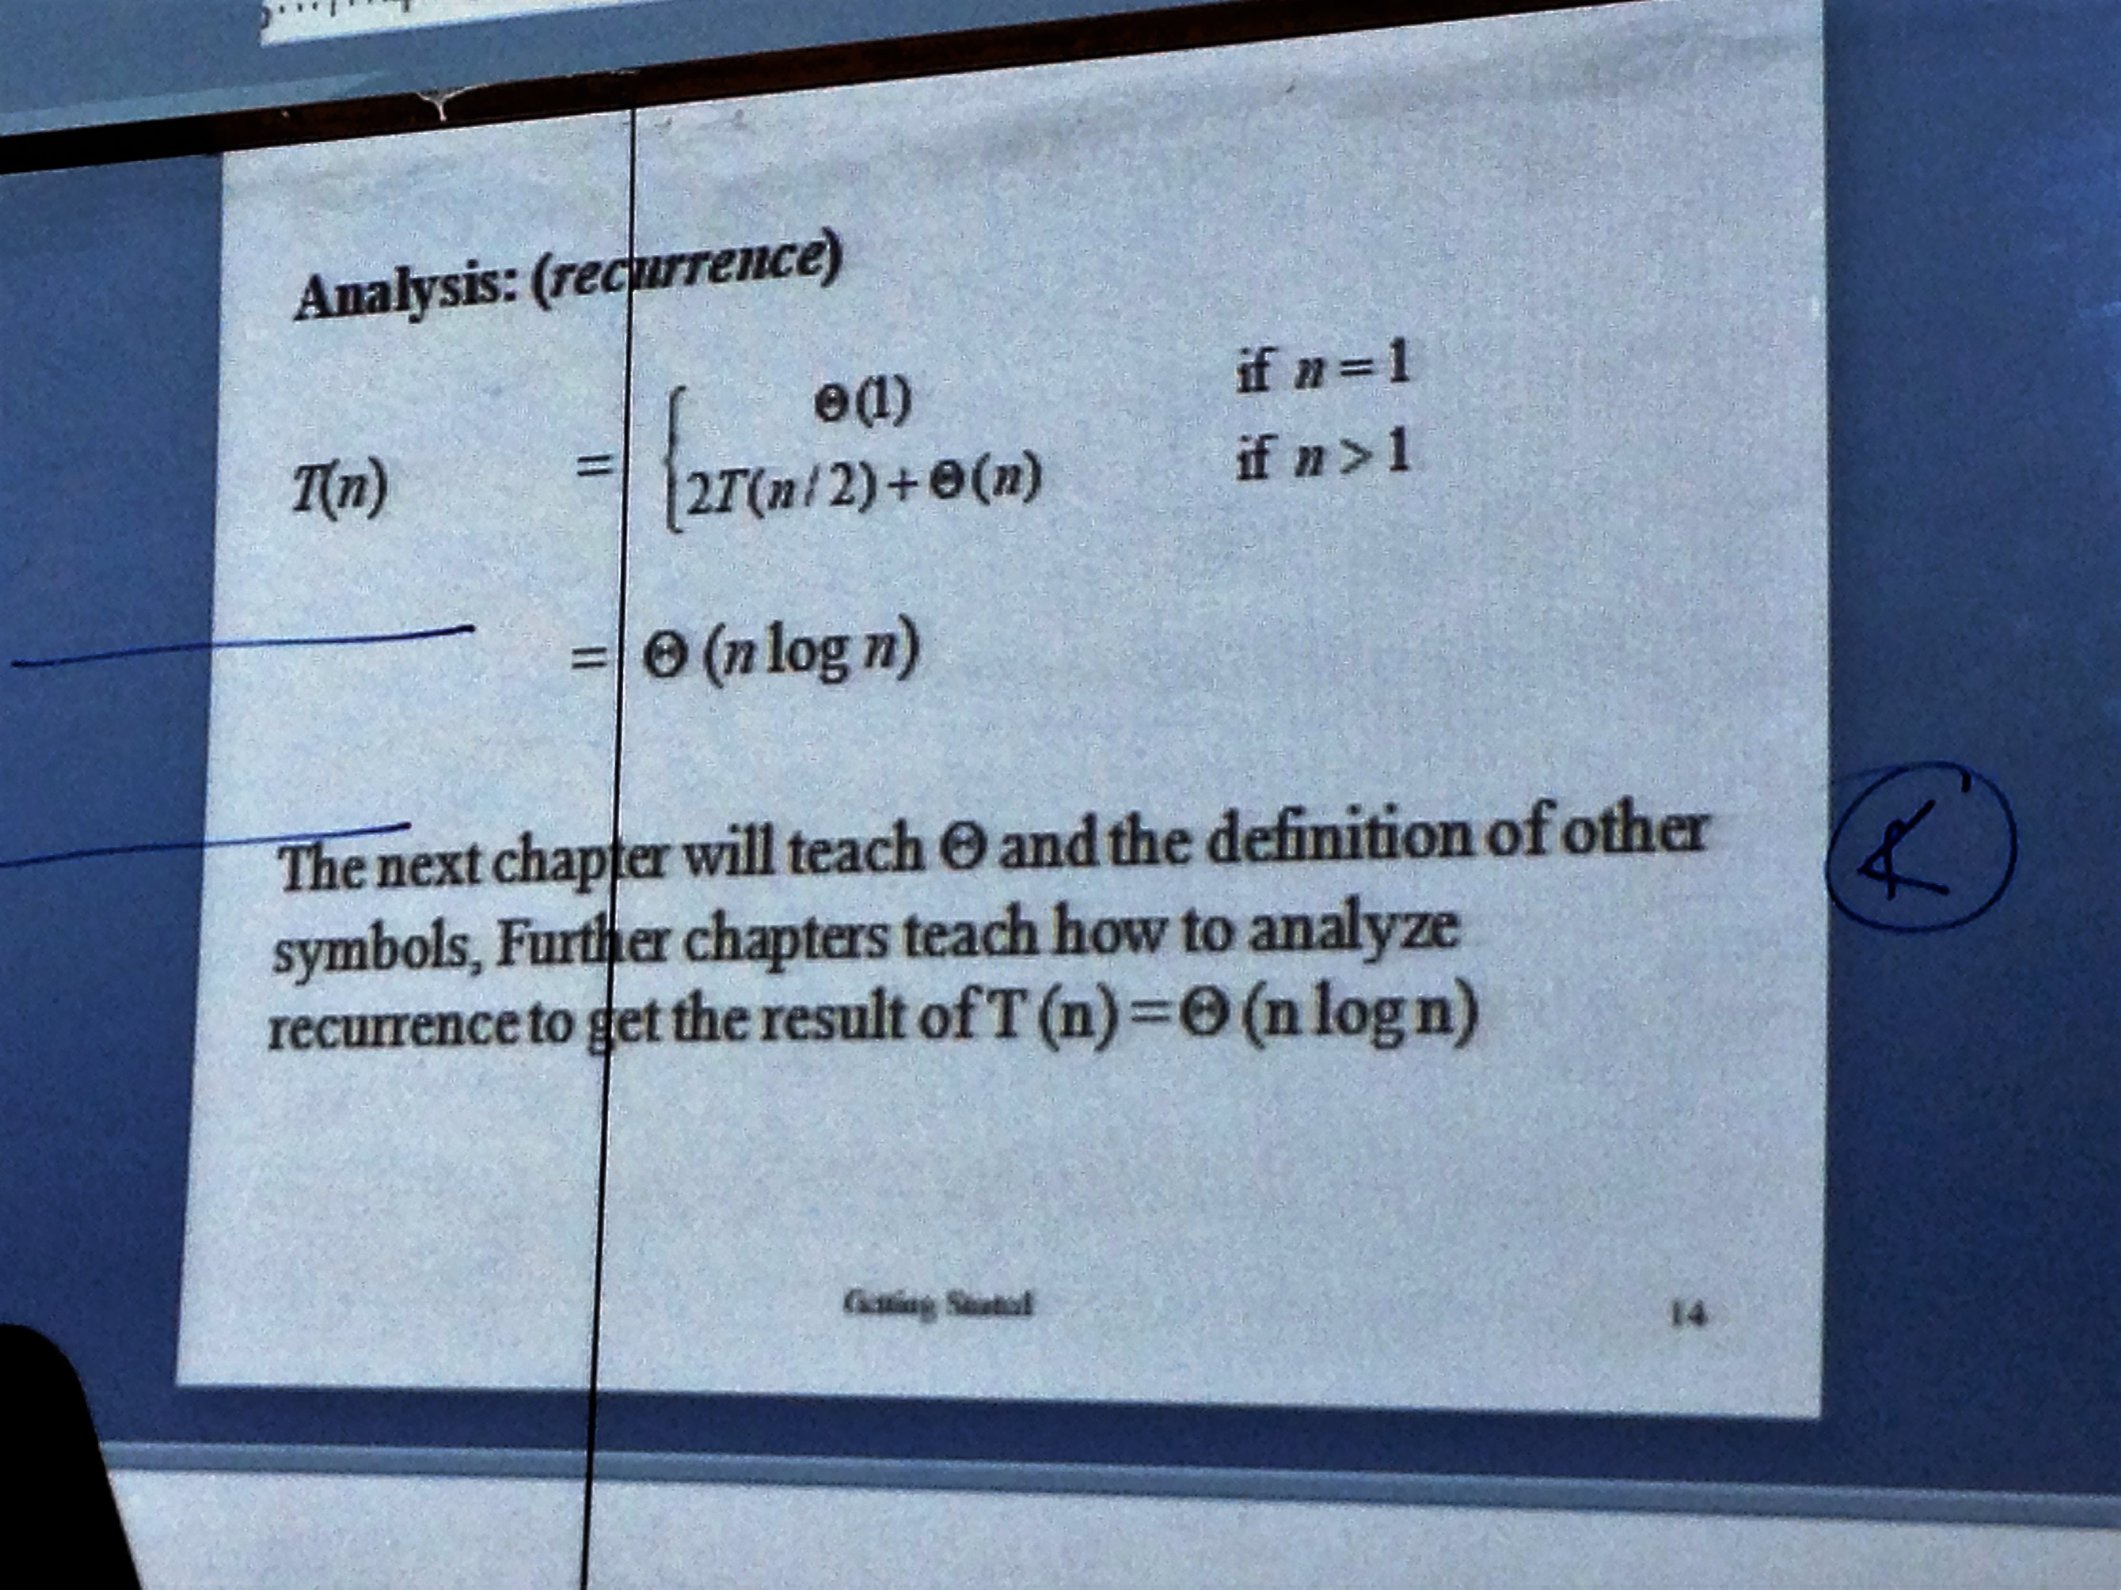
Analysis of rate of growth of merge sort

Slide 16
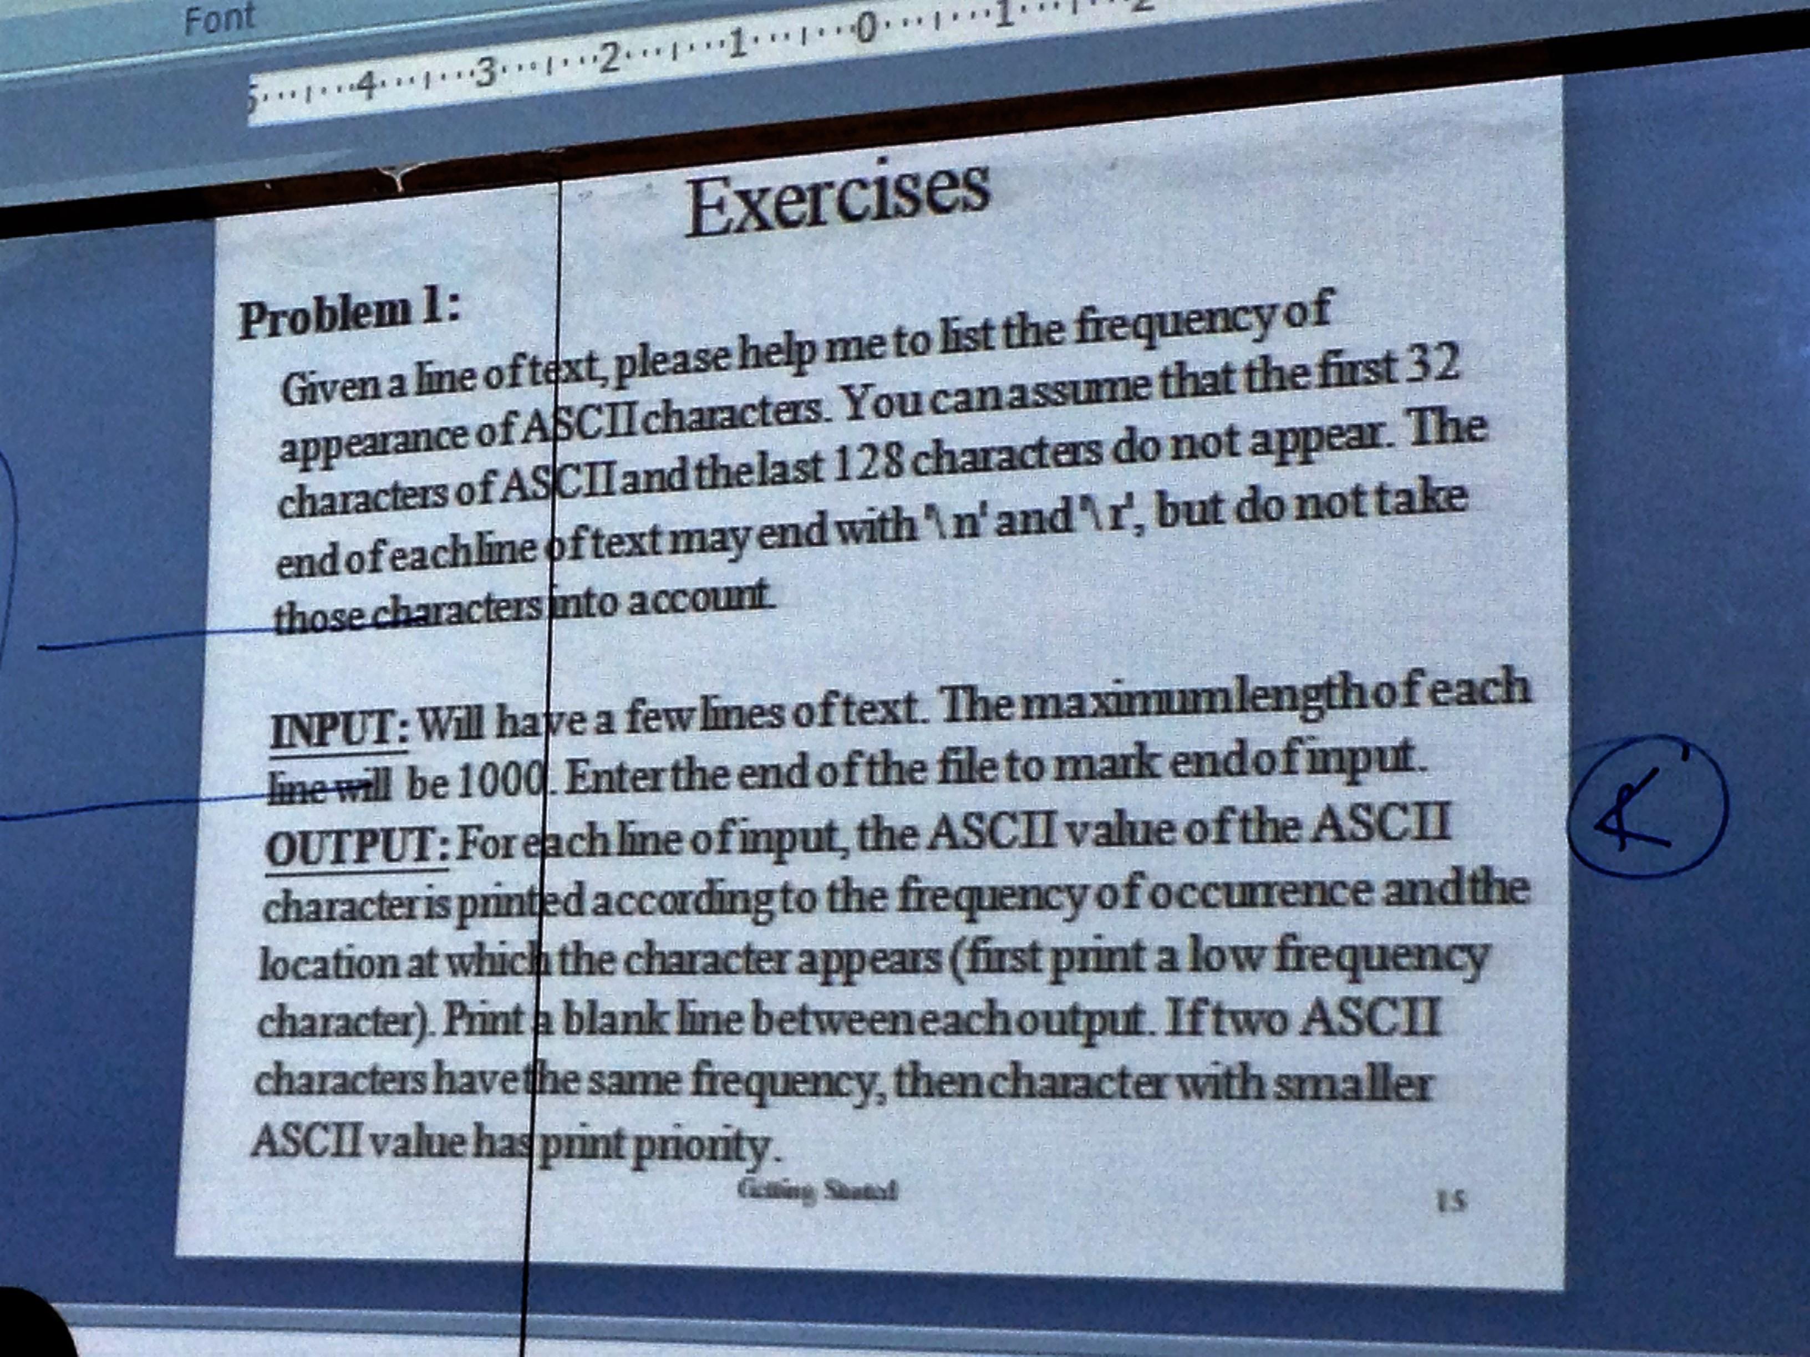
Problem 1

Slide 17
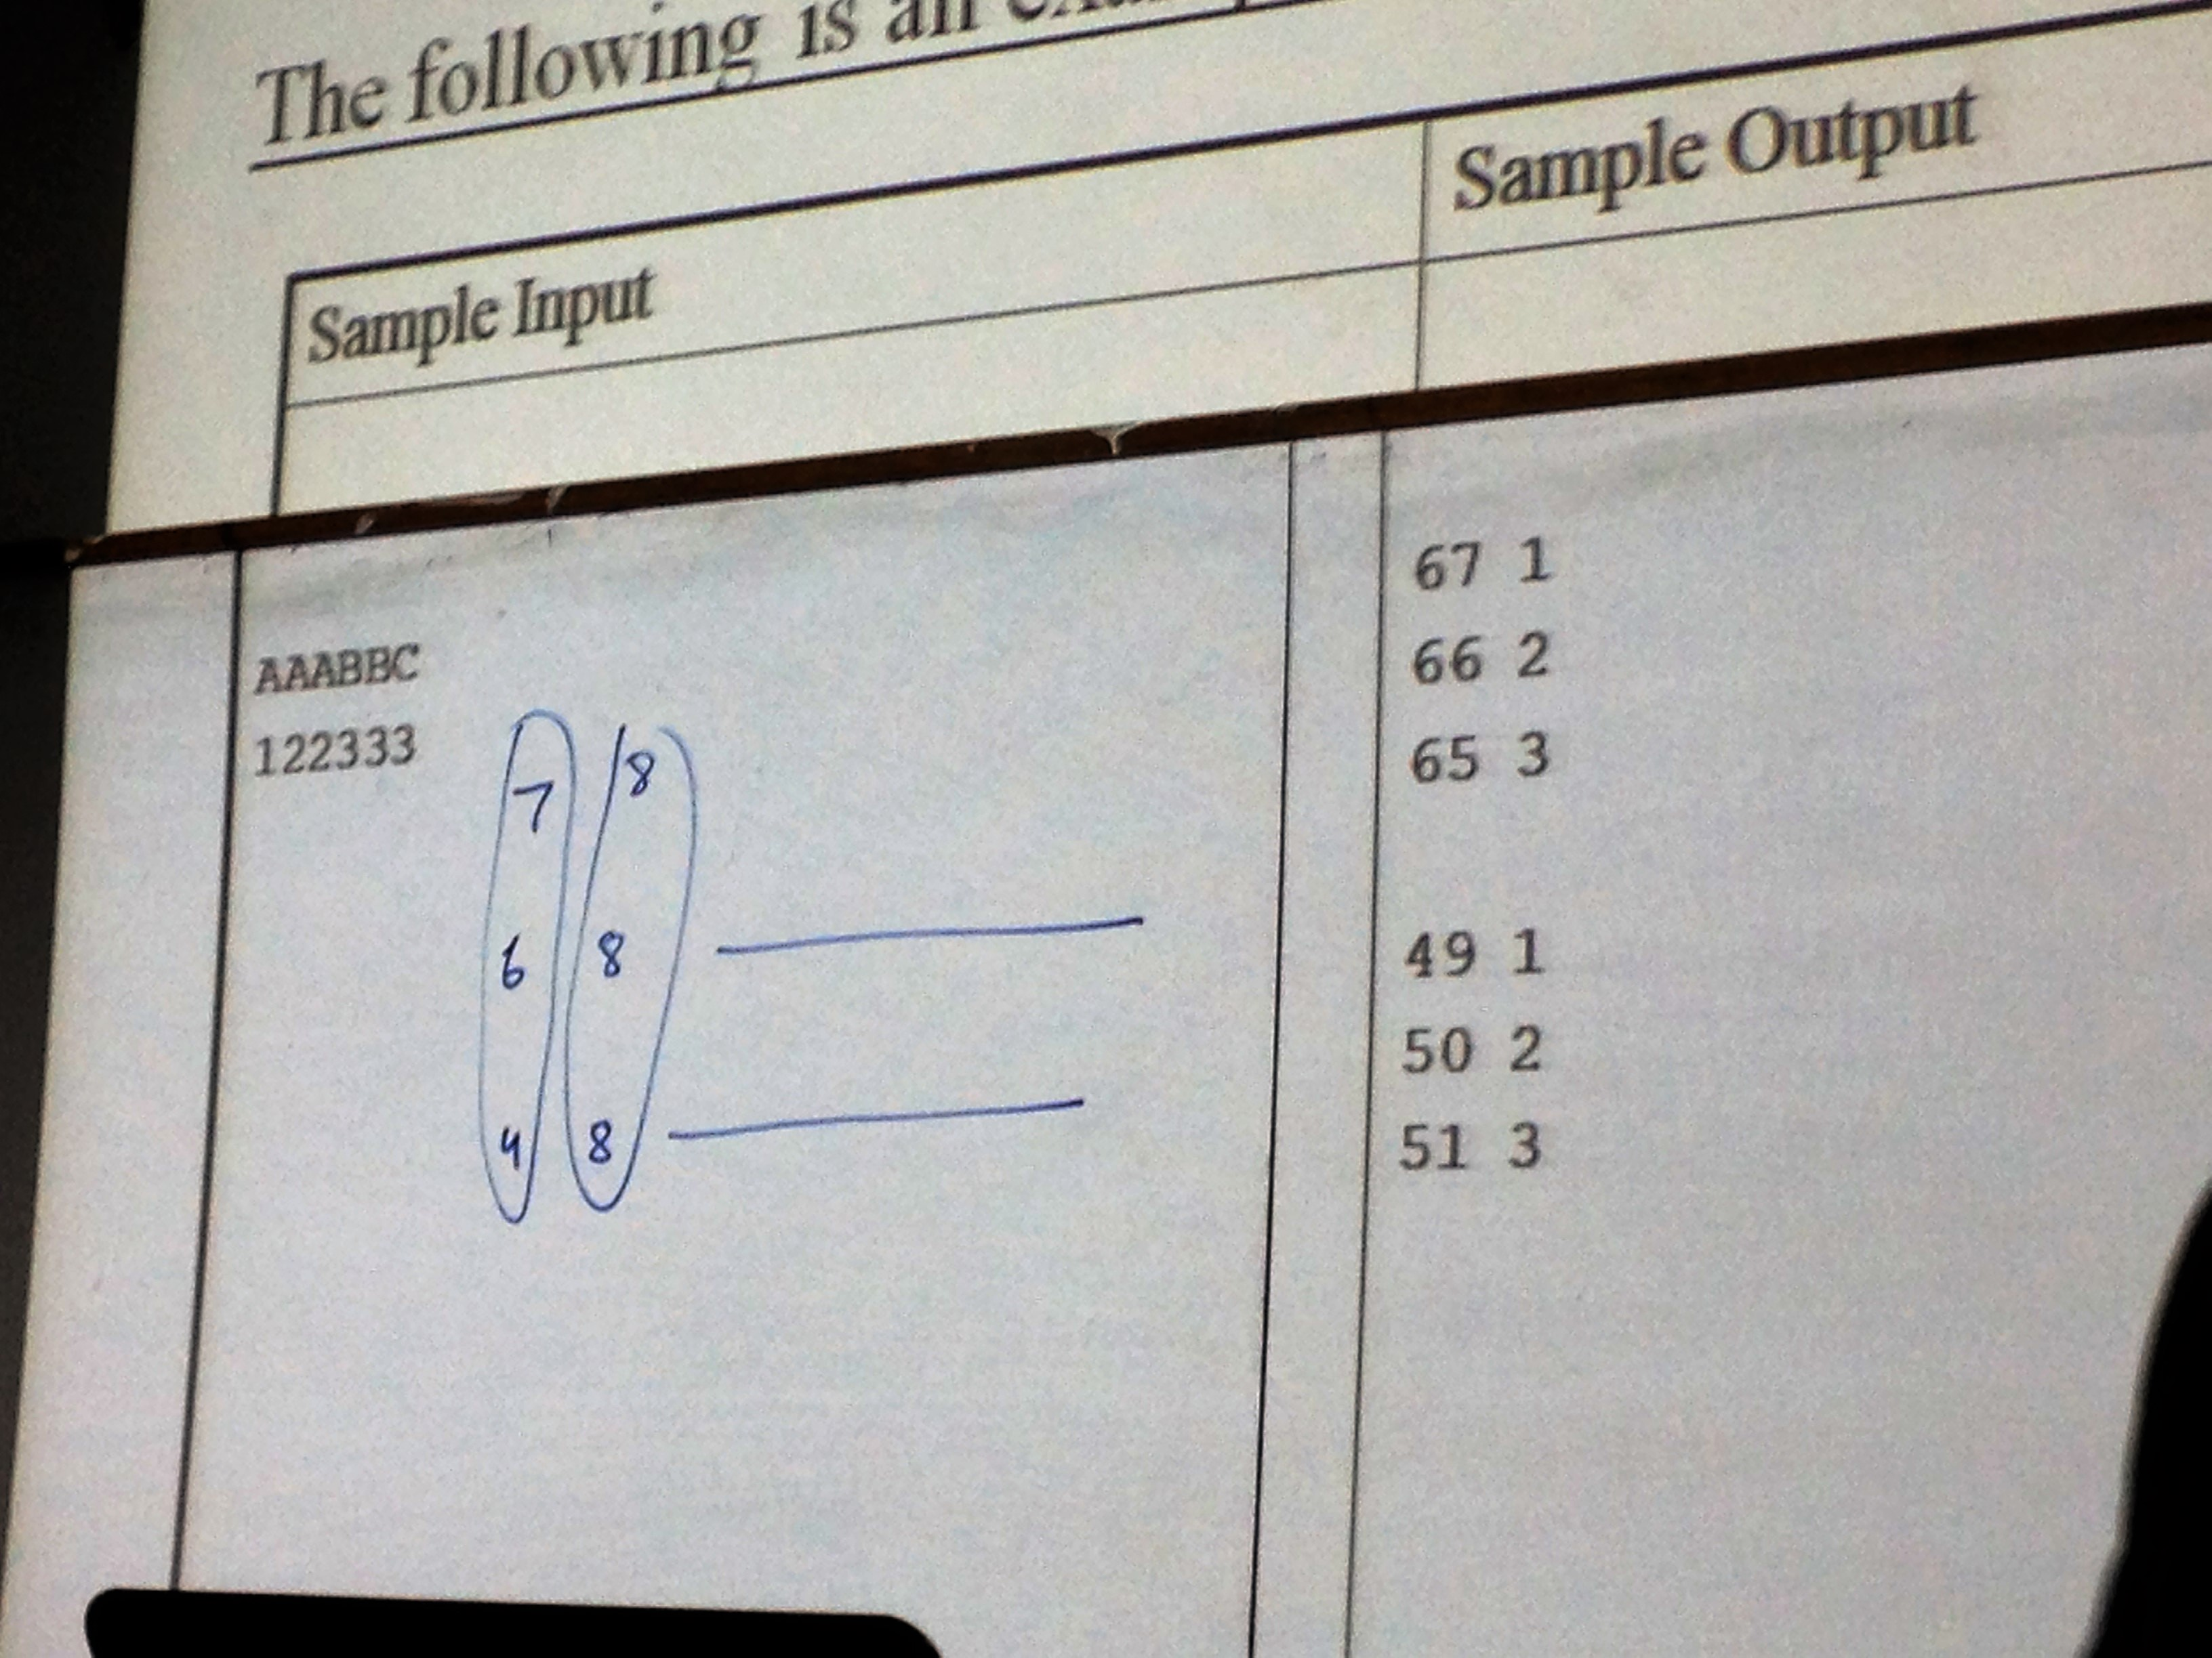
Solution of problem 1

